Slide 1
Multiplexing
Multiplexing is a technique used to combine and send the multiple data streams over a single medium. The process of combining the data streams is known as multiplexing and hardware used for multiplexing is known as a multiplexer.
Channels are often shared by multiple signals. After all, it is much more convenient to use a single wire to carry several signals than to install a wire for every signal. This kind of sharing is called multiplexing.
It can be accomplished in several different ways. We will present methods for time, frequency, and code division multiplexing.

Slide 2
Why Multiplexing?
The transmission medium is used to send the signal from the sender to the receiver. The medium can only have one signal at a time.
If there are multiple signals that share one medium, then the medium must be divided in such a way that each signal is given some portion of the available bandwidth. For example: If there are 10 signals and the bandwidth of the medium is 100 units, then the 10 units are shared by each signal.
When multiple signals share a common medium, there is a possibility of collision. The multiplexing concept is used to avoid such collision.
Transmission services are very expensive.

Slide 3
Concept of Multiplexing
The 'n' input lines are transmitted through a multiplexer and the multiplexer combines the signals to form a composite signal.
The composite signal is passed through a Demultiplexer and Demultiplexer separates a signal to component signals and transfers them to their respective destinations.

Slide 4
Multiplexing techniques
Frequency division multiplexing
Wavelength division multiplexing
Time division multiplexing
Code division multiplexing
Space division Multiplexing

Slide 5
Frequency Division Multiplexing
It is an analog technique.
Frequency Division Multiplexing is a technique in which the available bandwidth of a single transmission medium is subdivided into several channels.
In the above diagram, a single transmission medium is subdivided into several frequency channels, and each frequency channel is given to different devices. Device 1 has a frequency channel of range from 1 to 5.

Slide 6
Frequency Division Multiplexing
The input signals are translated into frequency bands by using modulation techniques, and they are combined by a multiplexer to form a composite signal.
The main aim of the FDM is to subdivide the available bandwidth into different frequency channels and allocate them to different devices.
Using the modulation technique, the input signals are transmitted into frequency bands and then combined to form a composite signal.

Slide 7
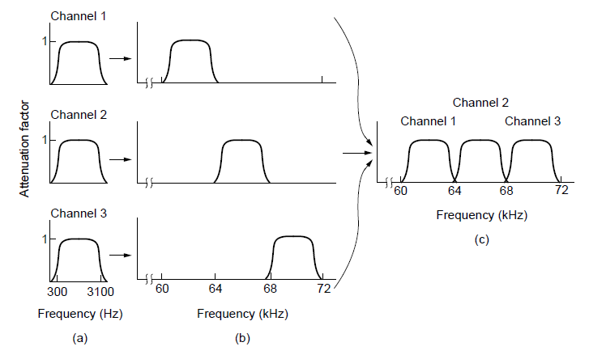
Frequency Division Multiplexing (2)
Frequency division multiplexing. (a) The original bandwidths. (b) The bandwidths raised in frequency. (c) The multiplexed channel.

Slide 9
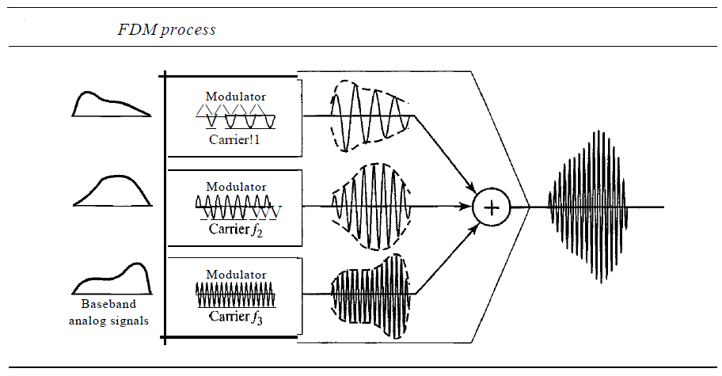

Slide 10
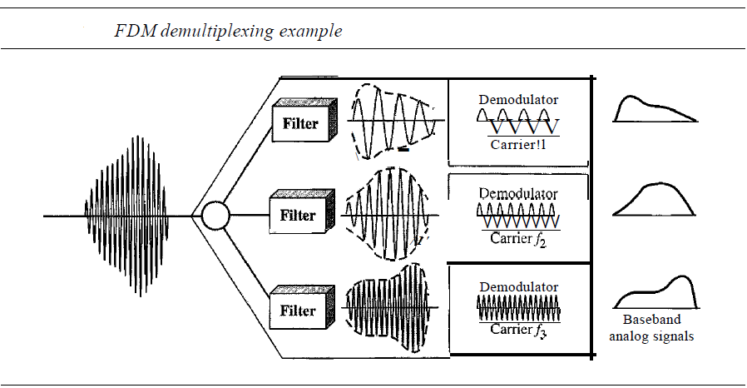

Slide 11
Advantages Of FDM:
FDM is used for analog signals.
The FDM process is very simple and easy modulation.
A Large number of signals can be sent through an FDM simultaneously.
It does not require any synchronization between sender and receiver.
Disadvantages Of FDM:
FDM technique is used only when low-speed channels are required.
It suffers the problem of crosstalk.
A Large number of modulators are required.
It requires a high bandwidth channel.
Applications Of FDM:
FDM is commonly used in TV networks.
It is used in FM and AM broadcasting. Each FM radio station has different frequencies, and they are multiplexed to form a composite signal. The multiplexed signal is transmitted in the air.

Slide 12
Wavelength Division Multiplexing (WDM)
Wavelength Division Multiplexing is same as FDM except that the optical signals are transmitted through the fibre optic cable.
WDM is used on fibre optics to increase the capacity of a single fibre.
It is used to utilize the high data rate capability of fibre optic cable.
It is an analog multiplexing technique.
Optical signals from different source are combined to form a wider band of light with the help of multiplexer.
At the receiving end, demultiplexer separates the signals to transmit them to their respective destinations.
Multiplexing and Demultiplexing can be achieved by using a prism.

Slide 14
Time Division Multiplexing
It is a digital technique.
In the Time Division Multiplexing technique, all signals operate at the same frequency at different times.
In the Time Division Multiplexing technique, the total time available in the channel is distributed among different users. Therefore, each user is allocated with different time interval known as a Time slot at which data is to be transmitted by the sender.
A user takes control of the channel for a fixed amount of time.
In the Time Division Multiplexing technique, data is not transmitted simultaneously rather the data is transmitted one by one.
In TDM, the signal is transmitted in the form of frames. Frames contain a cycle of time slots in which each frame contains one or more slots dedicated to each user.
It can be used to multiplex both digital and analog signals but is mainly used to multiplex digital signals.

Slide 15
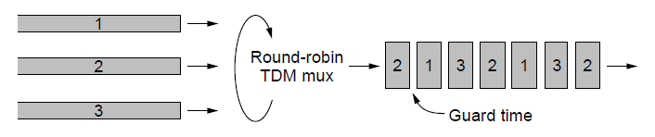
Time Division Multiplexing
round-robin fashion, each one periodically getting the entire bandwidth for a little burst of time.
Time Division Multiplexing (TDM).

Slide 16
There are two types of TDM:
Synchronous TDM
Asynchronous TDM

Slide 17
Synchronous TDM
A Synchronous TDM is a technique in which time slot is preassigned to every device.
In Synchronous TDM, each device is given some time slot irrespective of the fact that the device contains the data or not.
If the device does not have any data, then the slot will remain empty.
In Synchronous TDM, signals are sent in the form of frames. Time slots are organized in the form of frames. If a device does not have data for a particular time slot, then the empty slot will be transmitted.
The most popular Synchronous TDM are T-1 multiplexing, ISDN multiplexing, and SONET multiplexing.
If there are n devices, then there are n slots.

Slide 19
Disadvantages Of Synchronous TDM
The capacity of the channel is not fully utilized as the empty slots are also transmitted which is having no data.
The speed of the transmission medium should be greater than the total speed of the input lines.

Slide 20
Asynchronous TDM
An asynchronous TDM is also known as Statistical TDM.
An asynchronous TDM is a technique in which time slots are not fixed as in the case of Synchronous TDM. Time slots are allocated to only those devices which have the data to send. Therefore, we can say that Asynchronous Time Division multiplexer transmits only the data from active workstations.
An asynchronous TDM technique dynamically allocates the time slots to the devices.
In Asynchronous TDM, total speed of the input lines can be greater than the capacity of the channel.
Asynchronous Time Division multiplexer accepts the incoming data streams and creates a frame that contains only data with no empty slots.
In Asynchronous TDM, each slot contains an address part that identifies the source of the data.

Slide 22
Code Division Multiplexing
Code division multiplexing (CDM) is a technique used in telecommunications to allow multiple users to transmit data simultaneously over a single communication channel (over the entire frequency spectrum all the time).
In CDM, each user is assigned a unique code that is used to modulate their signal. The modulated signals are then combined and transmitted over the same channel.
At the receiving end, each user’s signal is demodulated using their unique code to retrieve their original data.
Multiple simultaneous transmissions are separated using coding theory.
Multiple signals from different users share the same frequency band.
Code Division Multiplexing is widely used in digital television and radio broadcasting, as well as in 3G mobile cellular networks, while 4G and 5G predominantly employ OFDM(Orthogonal Frequency Division Multiplexing).

Slide 23


Walsh codes(orthogonal)

Slide 24
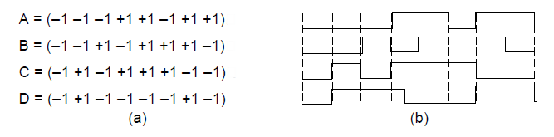
Code Division Multiplexing (1)
Chip sequences for four stations.
Signals the sequences represent

Slide 25
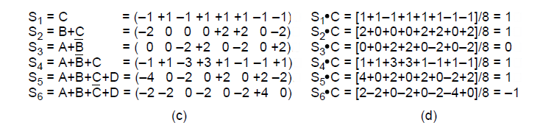
Code Division Multiplexing (2)
Six examples of transmissions.
Recovery of station C’s

Slide 26
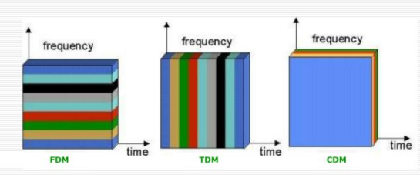
FDM Vs. TDM Vs. CDM

